Slide 1
Introducing the terminology
Enterprise software is computer software used to satisfy the needs of an organization.
Martin Fowler: "Enterprise applications are about the display, manipulation, and storage of large amounts of often complex data and the support or automation of business processes with that data."
https://en.wikipedia.org/wiki/Enterprise_software

Slide 2
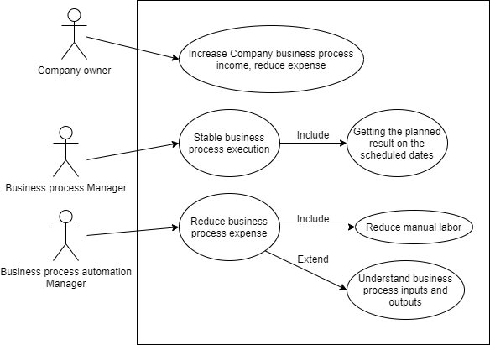
Enterprise Software Implementation/Support Actors

Slide 3
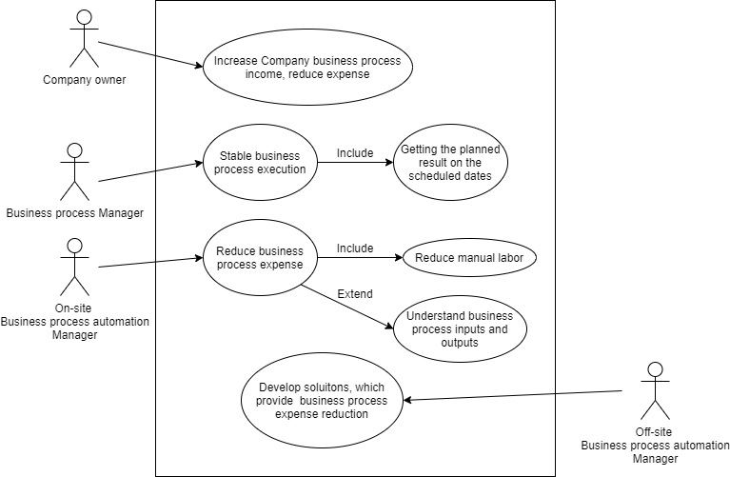
Enterprise Software Implementation/Support Actors

Slide 4
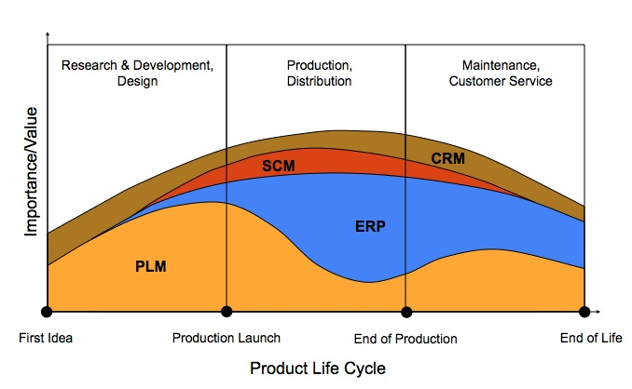

Slide 5
CRM - Customer relationship Management - is an approach to manage a company's interaction with current and potential customers. It uses data analysis about customers' history with a company to improve business relationships with customers, specifically focusing on customer retention and ultimately driving sales growth.
SCM - Supply Chain Management - the management of the flow of goods and services, involves the movement and storage of raw materials, of work-in-process inventory, and of finished goods from point of origin to point of consumption.
ERP - Enterprise Resource Planning - track business resources—cash, raw materials, production capacity—and the status of business commitments: orders, purchase orders, and payroll.
PLM - Product Lifecycle Management - is the process of managing the entire lifecycle of a product from inception, through engineering design and manufacture, to service and disposal of manufactured products. PLM integrates people, data, processes and business systems and provides a product information backbone for companies and their extended enterprise.

Slide 6







CRM vendors and software, examples
ERPNext
Opensource
https://en.wikipedia.org/wiki/Comparison_of_CRM_systems, https://bitnami.com/stacks/crm

Slide 7





ERP vendors and software, examples
ERPNext
Opensource
https://en.wikipedia.org/wiki/List_of_ERP_software_packages

Slide 8


ECM (enterprise content management)vendors and software, examples
Opensource

Slide 9




PLM vendors and software, examples

Slide 10



Enterprise System Development and
Business Process Development
Software implementation expert:
Knows the technical possibilities of implementation;
Offers implementation options;
Tells advantages and disadvantages.
Business processes expert:
Knows business outcomes;
Offers business implementation options;
Selects from the options offered by Developer.
End user / Employee:
Knows all the details of the business process execution;
Accepts or rejects developer’s work.

Slide 11
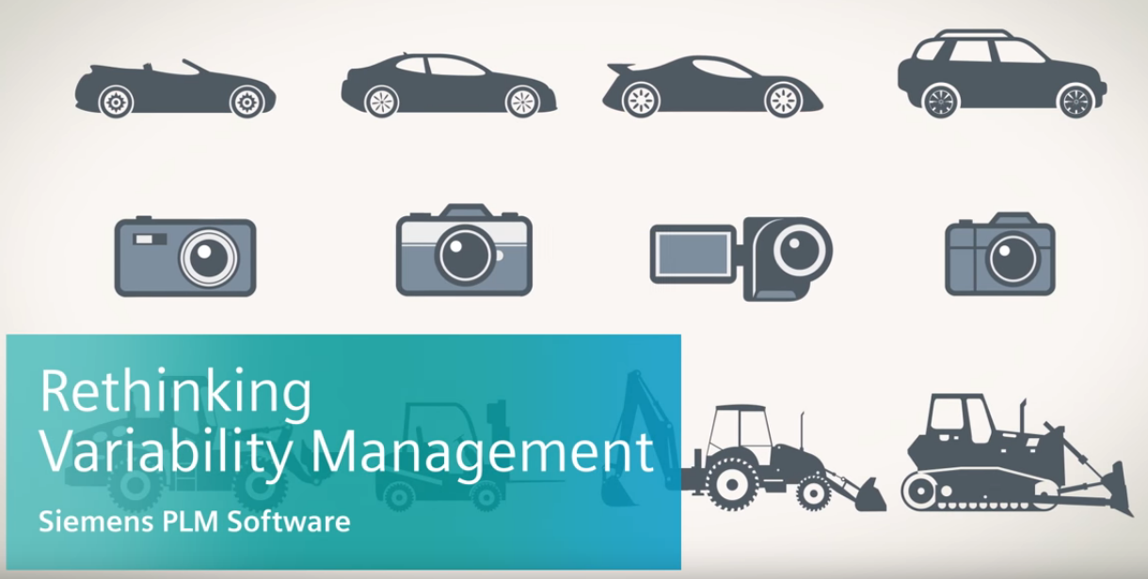
Business process example.
Product configurator Software in PLM

Slide 12
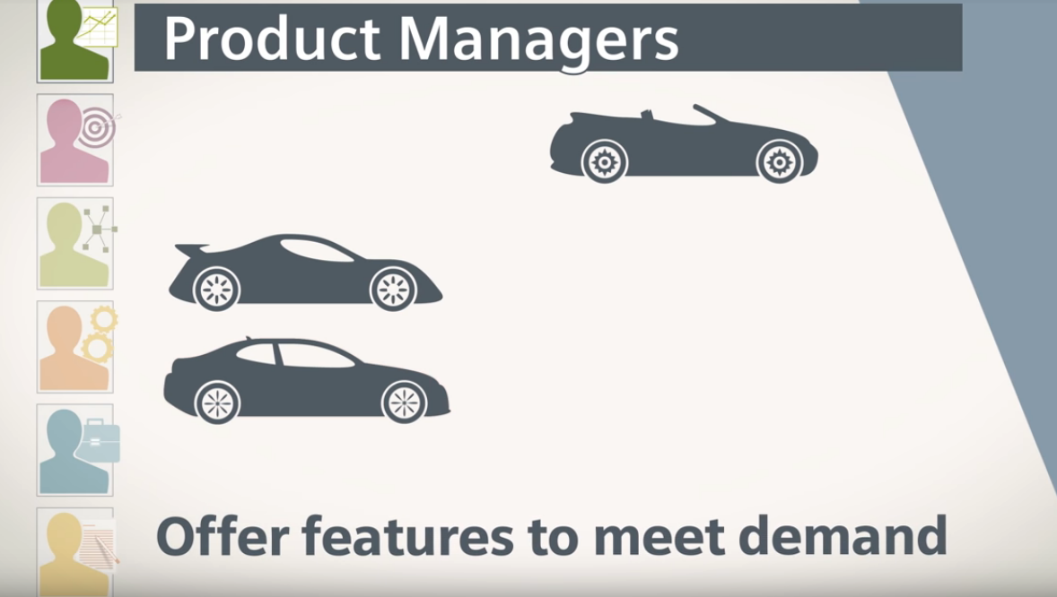

Slide 13
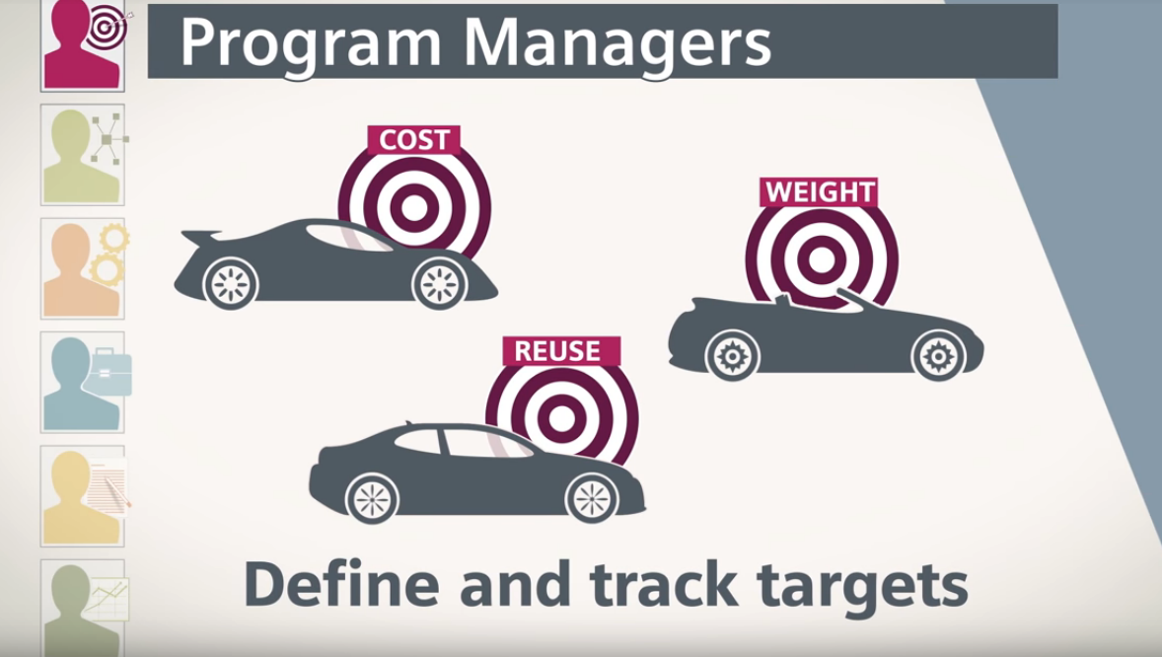

Slide 14
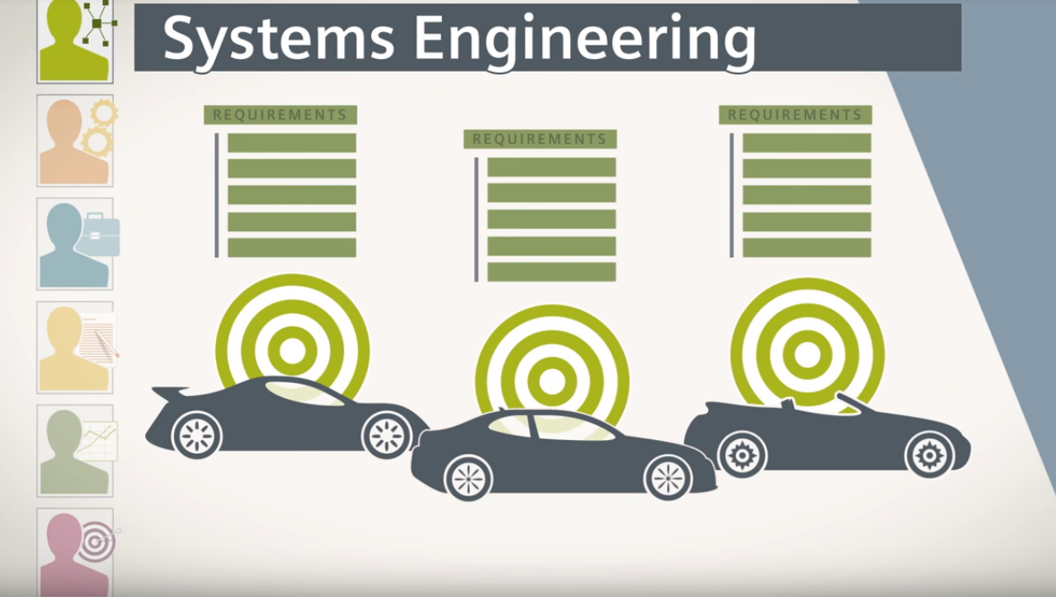

Slide 15
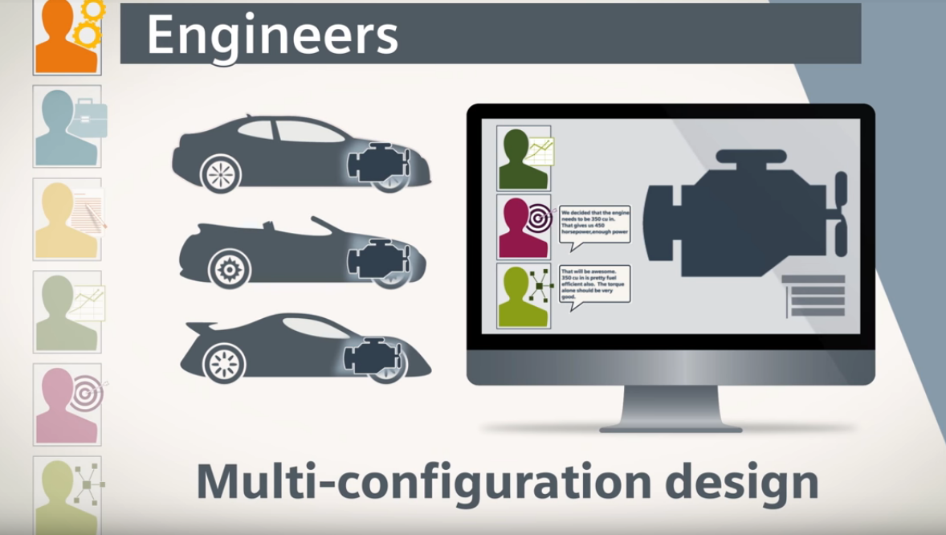

Slide 16
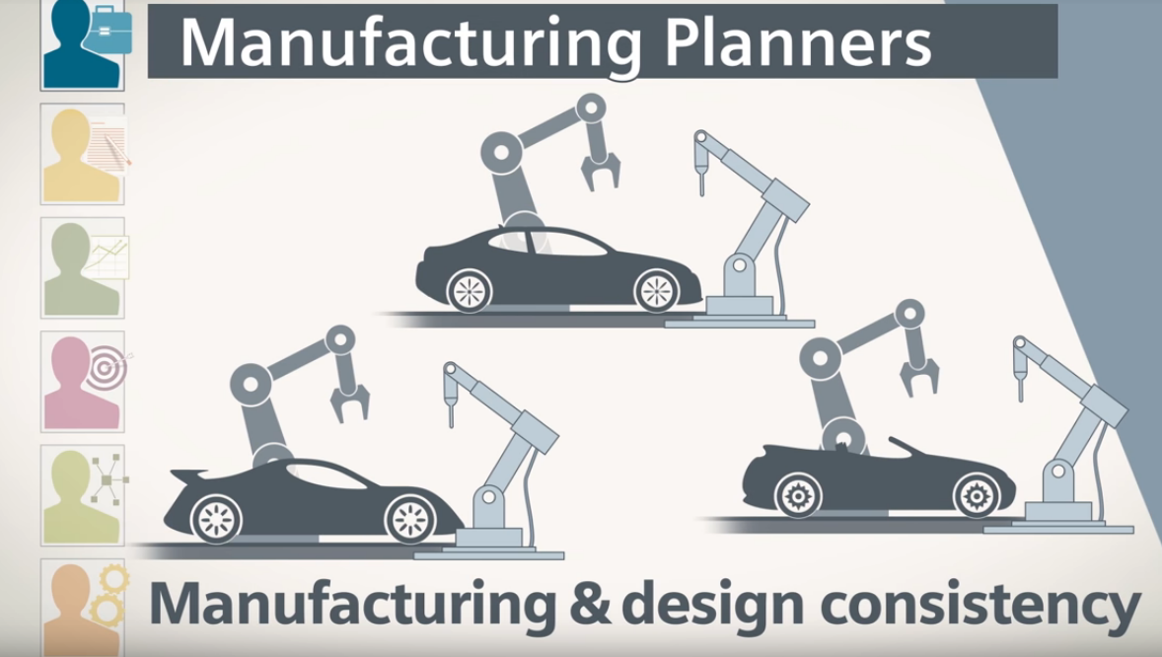

Slide 17
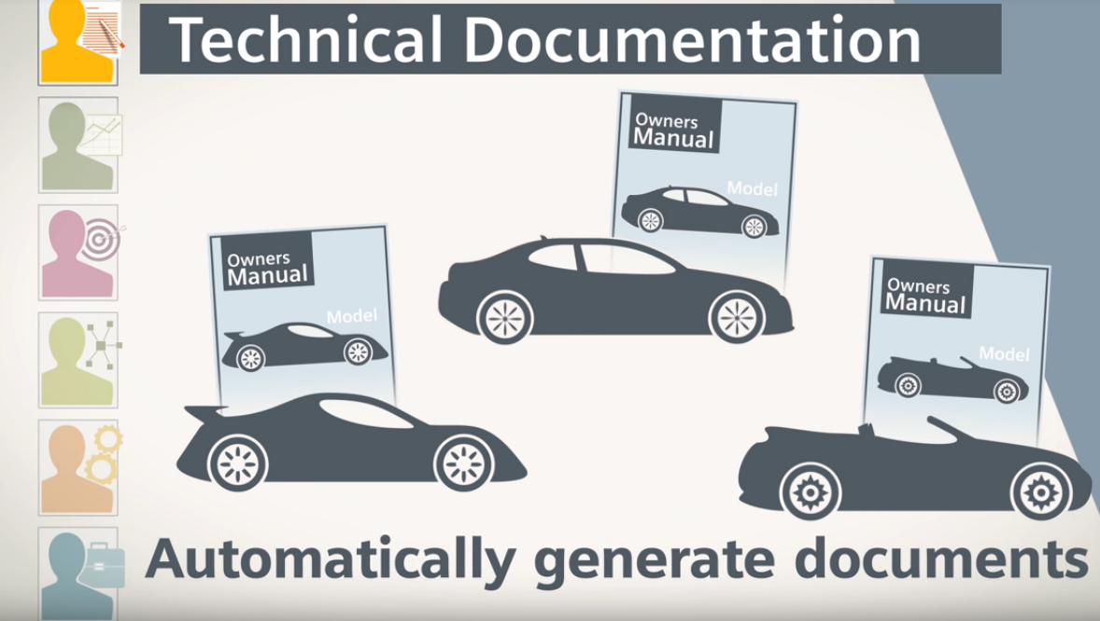

Slide 18
